Slide 1
Data Structures and Algorithms
LECTURE 02: LINKED LIST

Slide 2
OVERVIEW
Describe List structures
Describe self-referential structures
Explain types of linked lists
Singly Linked Lists
Doubly Linked Lists
Circular Lists
Lists in java.util
Reading at home

Slide 3
Lists
It’s a sequential structure
Sequence of items of a given base type
Items can be added, deleted, and retrieved from any position in the list
Can be implemented as array or dynamic array (to avoid identifying max size)
An alternative implementation is a linked list
Items are stored in nodes that linked together via pointers

Slide 4
Lists
It’s difficult to specify a single list Abstract Data Type (ADT) that covers both arrays and linked lists
One issue is the representation of position
Array position is represented by integer
Linked list position is represented by pointer
In case of an array with n elements, a “position” is simply an integer in the range from 0 to n-1.
In linked list, a position can be a pointer to one of the nodes in the list, but there are some subtleties involved (see later)

Slide 5
Operations of the ADT
getFirst()
getLast()
getNext(p)
getPrev(p)
get(p)
set(p, x)
insert(p, x)
remove(p)
removeFirst()
removeLast()
removeNext(p)
removePrev(p)
find(x)
size()

Slide 6
Drawbacks of Arrays
Array is very useful data structure in many situations. However, it has some limitations
Need size information for creation
Inserting an element in the middle of an array leads to moving other elements around
Deleting an element from the middle of an array leads to moving other elements around
Other data structures are more efficient for these cases

Slide 7
Self-referential structures
Employee
String name; int age;
Many dynamic data structures are implemented through the use of a self-referential structure
A self-referential structure is an object, one of this object member is a reference to another object of its own type.
With this arrangement, it’s possible to create ‘chains’ of data of varying form:
Linked List
DataNode
Employee info; DataNode next;
Tree

Slide 8
Linked Lists
A collection of nodes storing data and links to other nodes
A linear DS composed of nodes
Each node holds some info and reference to another node in the list
Types of linked lists
Singly-linked list
Doubly-linked list
Notes:
In programming, linear means that they are described by one (single) series of data.
Each data item has at most one predecessor and at most one successor
Non-linear means anything else
Linear are: Array, Linked List, Stack, Queue. Non linear are: tree, graph, etc

Slide 9
Singly linked list

Slide 10
Singly linked lists
Its node contains two data fields: info and next.
Info stores information which is usable by user
Next links it to its successor in the sequence
12
99
37
null
head
tail

Slide 11
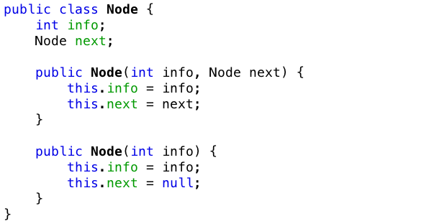
Node.java

Slide 12
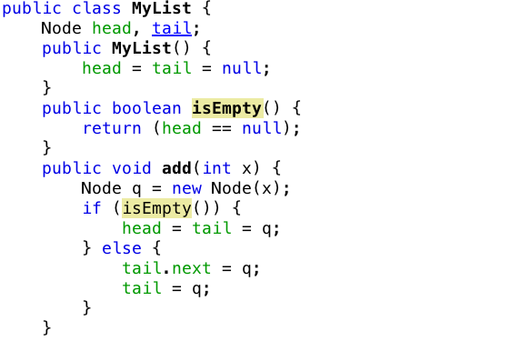
MyList.java

Slide 13
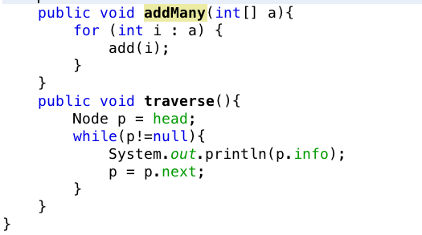
MyList.java (cont’)

Slide 14
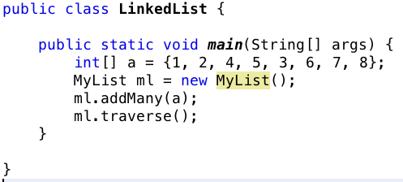
Main.java

Slide 15
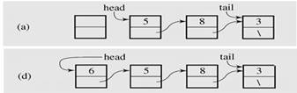
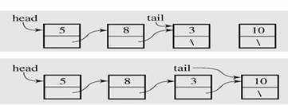
Insert node at beginning & end

Slide 16
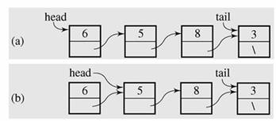
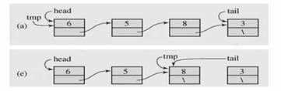
Deleting node at beginning & end

Slide 17
Exercise
Implementing java code for
Inserting node at the beginning and end
Deleting node at the beginning and end

Slide 18
Doubly linked list

Slide 19
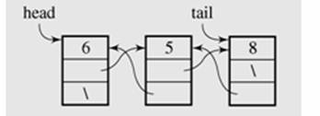
Intro
In doubly linked list, each node has two reference fields
one to the successor and
one to the predecessor

Slide 20
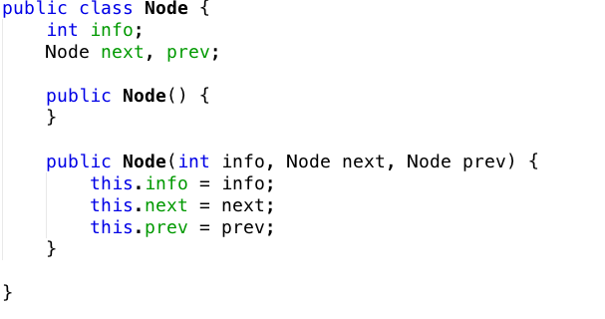
Node.java

Slide 21
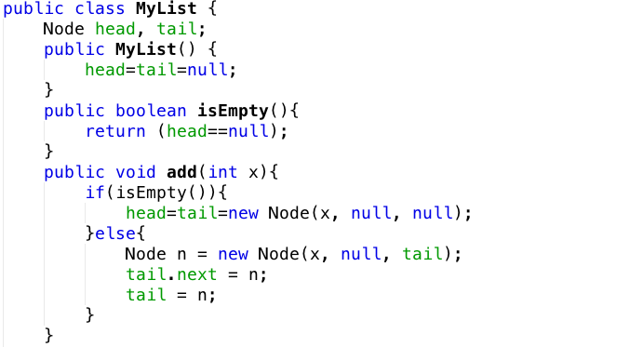
MyList.java

Slide 22
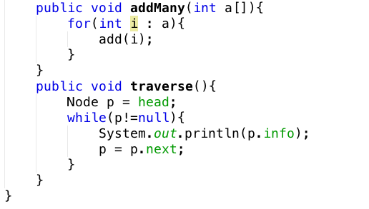
MyList.java (cont’)

Slide 23
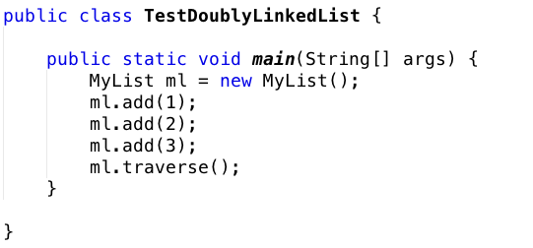
TestProgram

Slide 24
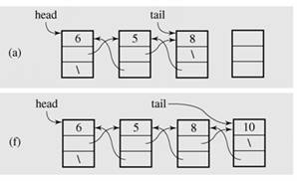
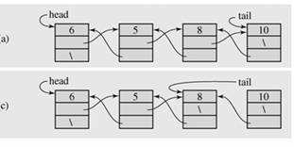
Adding/Deleting node at the end

Slide 25
Exercise
Implement in java adding/deleting node at the end

Slide 26
Circular Lists

Slide 27
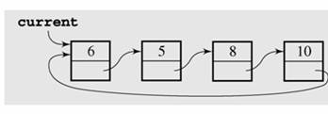
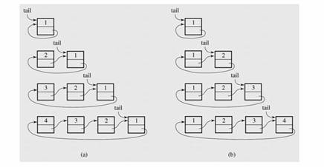
Intro
Circular list
Circular list is when nodes form a ring: the list is finite and each node has a successor
Add
new item

Slide 28
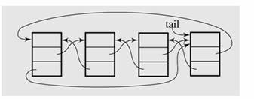
Circular Doubly Linked List

Slide 29
List in Java.util
LinkedList

Slide 30
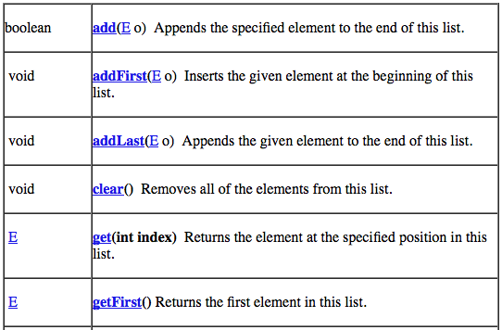
LinkedList class

Slide 31
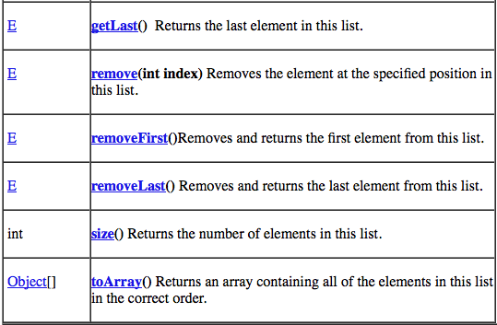
LinkedList class

Slide 32
Exercises
Write a program to test LinkedList in Java

Slide 33
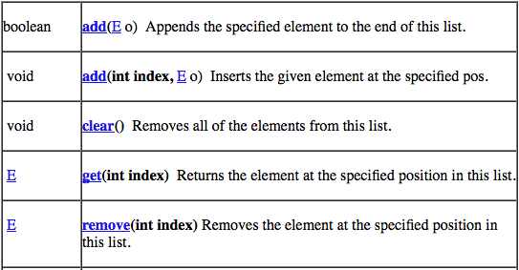
ArrayList class

Slide 34
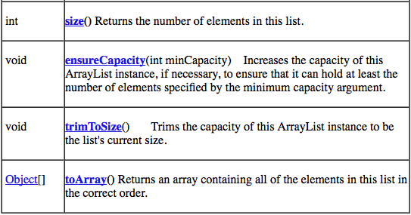
ArrayList class

Slide 35
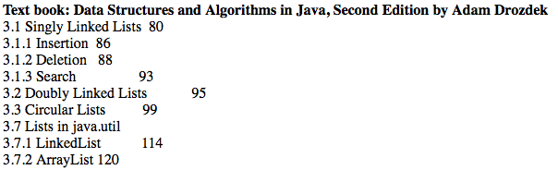
Further readings

Slide 36
Summaries
Describe List structures
Describe self-referential structures
Explain types of linked lists
Singly Linked Lists
Doubly Linked Lists
Circular Lists
Lists in java.util
Reading at home

Slide 37
The end

